Slide 1

Conference Booking Application
This presentation outlines a C program designed to manage room reservations buildings. The system allows users to add, remove, reserve, cancel, and display rooms and their respective time slots. It provides an efficient way to handle room bookings and maintain an organized schedule for various spaces within a building.

Slide 2
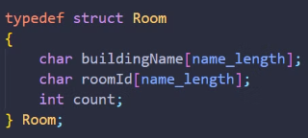
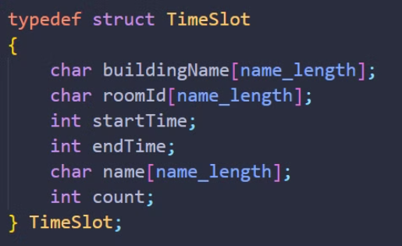
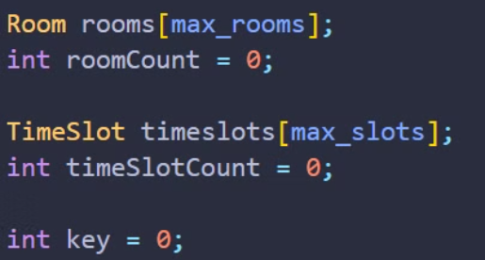
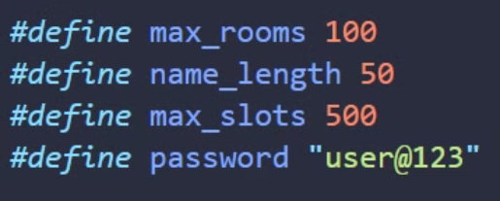
Key Data Structures
Room Structure
TimeSlot Structure
Global Variables
The Room structure represents a room with its building name, room ID, and the count of rooms. This structure is essential for keeping track of available spaces within the building.
The TimeSlot structure represents a reservation with details about the building, room, start and end times, the name of the person reserving it, and a count of time slots. This structure allows for efficient management of bookings.
The program uses arrays rooms and timeslots to store rooms and reservations respectively. Counters roomCount and timeSlotCount track the number of rooms and reservations. An integer key is used for password authentication.

Slide 3
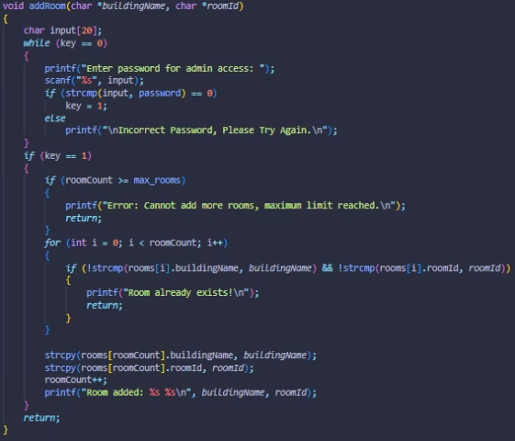
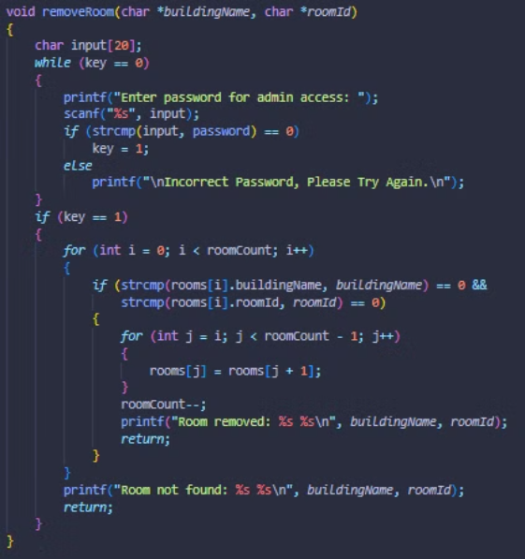
Core Functions
1.Room Management
The addRoom function adds a new room after verifying the admin password. The removeRoom function removes an existing room after password verification. These functions ensure proper control over the available spaces.

Slide 4
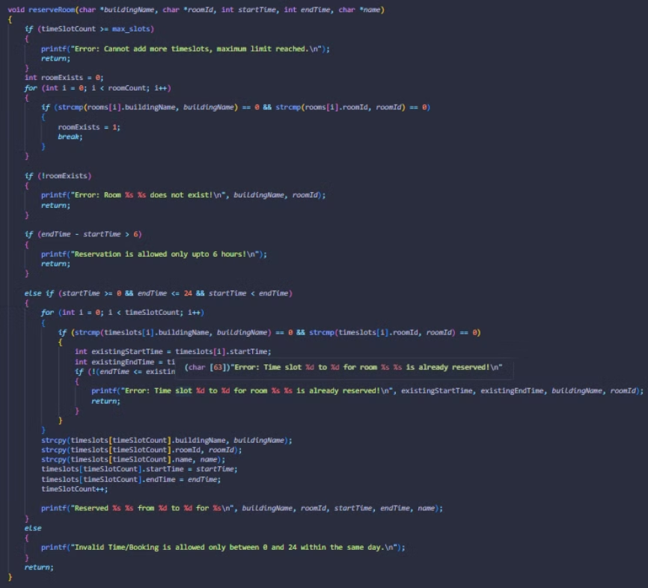
2.Reservation Handling
The reserveRoom function reserves a room for a specific time slot if it exists and does not overlap with existing reservations. The cancelRoom function cancels an existing reservation based on building name, room ID, start time, and end time.

Slide 5
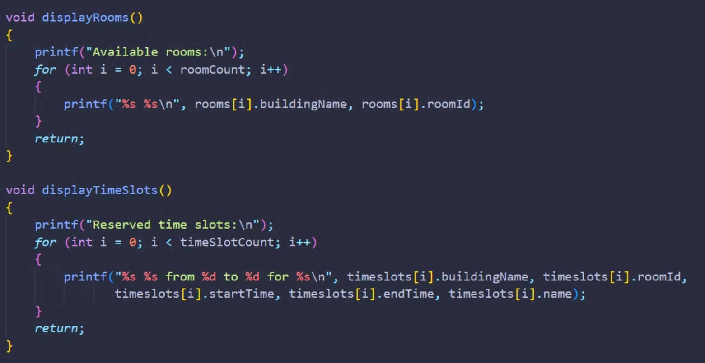
Display Functions
The displayRooms and displayTimeSlots functions called by the rooms and timeslots command respectively are used to display the list of added rooms and the list of reserved timeslots respectively.

Slide 6
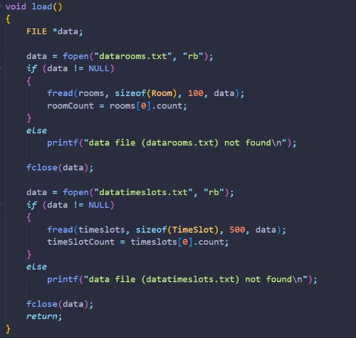
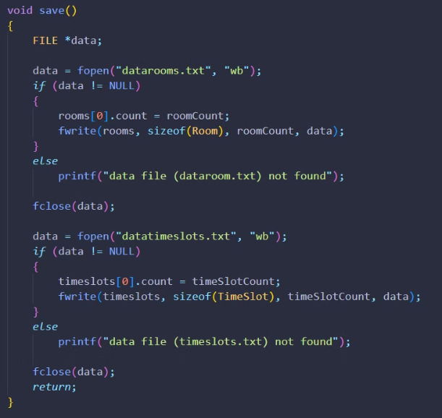
File Operations
The load function loads previously saved room and timeslot data from files. The save function saves current room and timeslot data to files. These functions allow for persistent storage of room data across sessions, ensuring that information is not lost between program runs.

Slide 7
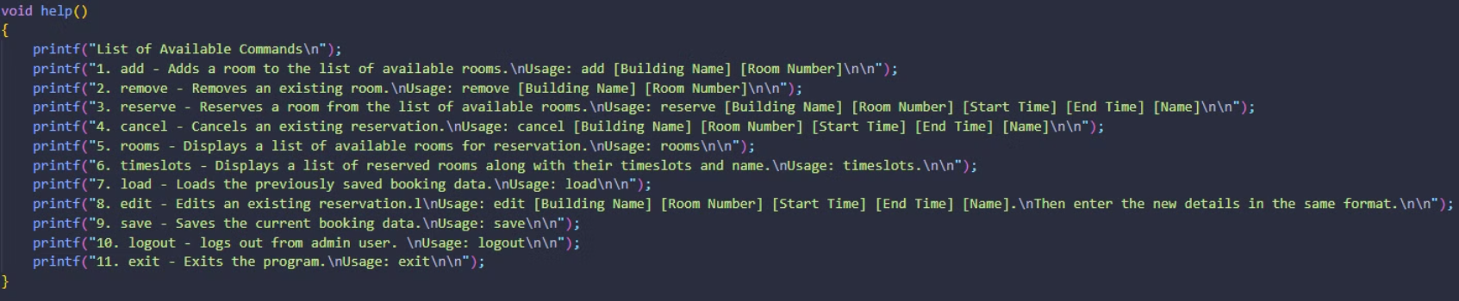
User Guidance
The help function displays available commands for user guidance. This feature assists users in navigating the system and understanding the available options for managing room reservations.

Slide 8
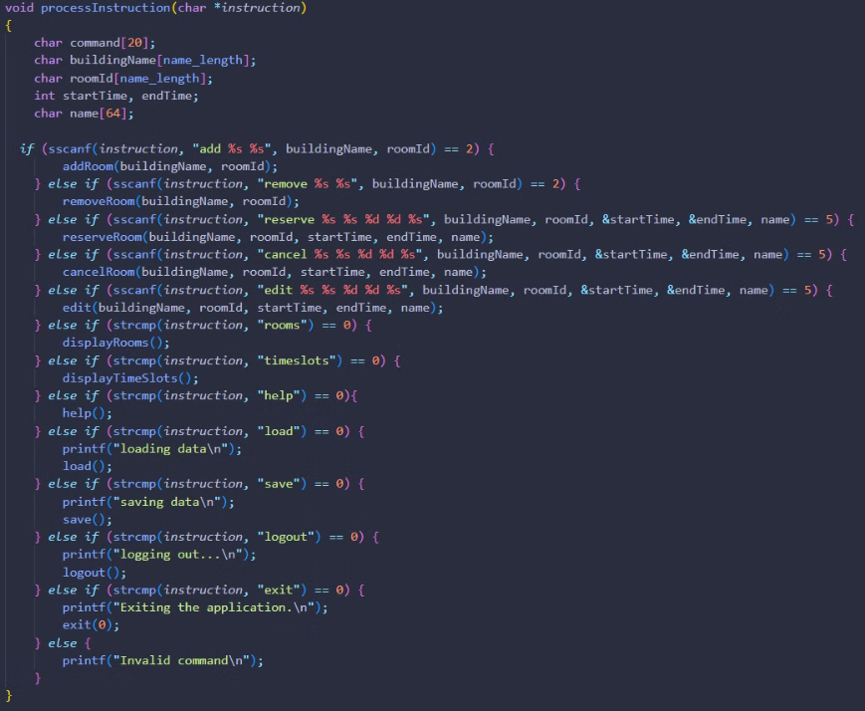
Command Processing
The processInstruction function parses user input commands and calls the appropriate functions based on the command. This function serves as the central hub for interpreting user instructions and executing the corresponding actions.

Slide 9
Security and Validation
1
Password Protection
2
Room Management Checks
3
Reservation Validation
The functions addRoom and removeRoom require an admin password (user@123) for access. If the password is incorrect, it prompts the user until the correct password is entered. This ensures that only authorized personnel can modify the room inventory.
Reservations check whether the room exists before proceeding. They also verify that requested time slots do not overlap with existing ones. A valid reservation requires that start time is less than end time and both are within a 24-hour format. These validations ensure that all reservations are logically sound and do not conflict with existing bookings.
Adding a room checks if the maximum limit is reached before adding it to the list. Removing a room involves searching through the list and shifting elements to fill any gaps left by the removed room. These checks maintain the integrity of the room data.

Slide 10




Program Flow
Main Loop Initialization
The program runs in an infinite loop where it prompts the user for commands. This continuous operation allows for ongoing interaction with the system.
Command Processing
It processes these commands by converting them to lowercase (to ensure case-insensitivity) and calling the relevant function. This step interprets user input and directs the program flow accordingly.
Function Execution
Based on the processed command, the appropriate function is called to perform the requested action, such as adding a room, making a reservation, or displaying information.
Continuous Operation
The loop continues, allowing for multiple operations to be performed in a single session until the user chooses to exit the program.

Slide 11
User Interface and Commands
Command
Description
Usage
add
Adds a new room
add [Building Name] [Room Number]
remove
Removes an existing room
remove [Building Name] [Room Number]
reserve
Reserves a room for a time slot
reserve [Building Name] [Room Number] [Start Time] [End Time] [Name]
cancel
Cancels an existing reservation
cancel [Building Name] [Room Number] [Start Time] [End Time] [Name]
rooms
Displays all available rooms
rooms
timeslots
Displays all reserved time slots
timeslots
load
Loads booking data
load
edit
Edits an existing reservation
edit [Building Name] [Room Number] [Start Time] [End Time] [Name]
save
Saves booking data
save
logout
logs out from admin user
logout
exit
Exits the program
exit

